Slide 1
Changing the monetary policy game using quantitative easing:
Is it doing the job?
AABRI Conference Las Vegas 2013
October 9-12, 2013
Prof. Ray M. Valadez, Pepperdine University

Slide 2
The U.S. unemployment and mortgage rates:
A relationship study
Last Year’s Presentation
Ray M. Valadez
Pepperdine University
AABRI Conference LV2012-Paper 12079
October 4-6, 2012

Slide 3
Fed announces new mortgage bond-buying plan, keeps interest rates low
The Fed’s steps were in many ways remarkable: For the first time, it made a definitive promise that it would keep interest rates ultra-low even if the economy starts to recover. That sent a clear signal that for years it will be cheap for consumers to borrow to buy homes and cars or for businesses to get loans to expand. Washington Post Sept. 9,2013
http://www.washingtonpost.com/business/economy/fed-expected-to-announce-stimulus-thursday/2012/09/13/38a31be2-fda4-11e1-8adc-499661afe377_story.html
Retrieved September 20, 2012

Slide 4
News Headlines-Fed actions' economic impact-Washington Post
The Federal Reserve has launched several programs to lift economic growth over the past few years. The programs seem to have had the effect of raising stock values, reducing the unemployment rate and reducing mortgage rates -- all of which should increase Americans' wealth, make them feel more confident and make it easier to buy a house. In addition to keeping interest rates ultra-low, the Fed earlier launched two rounds of quantitative easing -- purchases of mortgage and Treasury bonds -- and two "Twist" programs that target long-term interest rates specifically.
http://www.washingtonpost.com/business/economy/fed-actions-economic-Retrereimpact/2012/09/13/4ab78694-fe01-11e1-8adc-499661afe377_graphic.html
Retrieved September 20, 2012

Slide 5

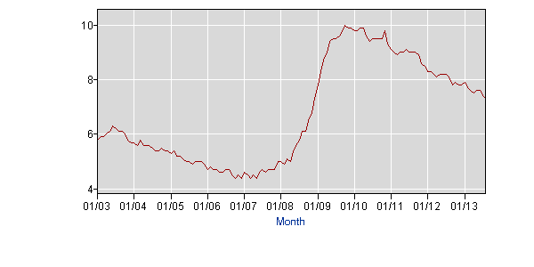
Figure 1. U.S. Unemployment Rate
Source: Retrieved October 7, 2013 from http://data.bls.gov/timeseries/LNS14000000

Slide 6
The Fed’s Actions seem to indicate that the unemployment rate is correlated to these variables?
Interest Rates
  10-Yr U.S. Treasury Yields
  30-Yr Fixed Mortgage Rates
Housing
  New starts and
  Resale
  Case/Shiller Housing 20-Index

Slide 7
Recent QE’s – QE1, QE2, & QE3
QE1:
QE2:
QE3:

Slide 8
Recent QE’s – QE1, QE2, & QE3
QE1:
QE2:
QE3:

Slide 9
What the literature say?
QE1:
QE2:
QE3:

Slide 10
30-Yr Fixed Mortgage Rate Versus
10-Yr U. S. Treasury Rate

Slide 11
U.S. Unemployment Rate Versus
10-Yr U. S. Treasury Rate

Slide 12
U. S. Unemployment Rate Versus
30-Yr Fixed Mortgage Rate

Slide 13
Pearson Correlation Between Variables (Jan 2007-July2012)
Last Year’s Presentation
 | Unemployment Rate | Case/Shiller-20 Index | 30-Yr Mortgage Rate | 10-Yr Treasury Rate
Unemployment Rate | 1.000000 | -0.898014 | -0.784411 | -0.610855
Case/Shiller Index | -0.898014 | 1.000000 | 0.816641 | 0.797085
30-Yr Mortgage Rate | -0.784411 | 0.816641 | 1.000000 | -0.784411
10-Yr Treasury Rate | -0.610855 | 0.797085 | -0.784411 | 1.000000

Slide 14
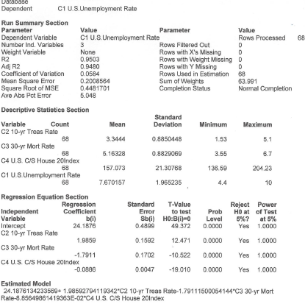
Robust Multiple Regression Using Huber's Method (C=1.345)

Slide 15
The U. S. Unemployment rate may be estimated as follows:
equals the Y intercept at x=0 or 24.19
equals 1.99 or coefficient of the 10-Year U. S. Treasury Rate
equals 10-Year U.S. Treasury rate
equals (-0.89) or coefficient of the Case/Shiller housing index
equals the Case/Shiller housing 20 index
equals (-1.79) or coefficient of the 30-Year Freddiemac pmms mortgage rate
equals the 30-Year Freddiemac pmms mortgage rate
equals the estimated error
Estimated Model using NCSS Huber’s robust multiple regression :
24.1876134233569+ 1.98592794119342*C2 10-yr Treas Rate-0.0885649861419363*C4 U.S. C/S House 20Index-1.79111500054144*C3 30-yr Mort Rate

Slide 16
Table 2. Analysis of Predictive Model (Aug 2012-Jul 2013)
Analysis of an Unemployment Rate Predictive Model by Ray M. Valadez-2013
unemployment rate = 24.188 + (1.99 X 10-yr treas) - (1.79 X 30-yr mort rate) - (.089 X c/s 20 index)
Y intercept | 10-yr treasury | C/S House 20-Index | 30-Yr Mortg-Rate | Unemploy Rate | Unemploy Rate
24.18761342 | 1.985927941 | -0.088564986 | -1.791115001 | Actual | Predicted | difference | % difference
2012 Aug | 1.68 | 145.81 | 3.6 | 8.10 | 8.16 | -0.06 | -0.77%
2012 Sep | 1.72 | 146.21 | 3.47 | 7.80 | 8.44 | -0.64 | -8.19%
2012 Oct | 1.75 | 146.02 | 3.38 | 7.90 | 8.68 | -0.78 | -9.83%
2012 Nov | 1.65 | 145.81 | 3.35 | 7.80 | 8.55 | -0.75 | -9.62%
2012 Dec | 1.72 | 146.08 | 3.35 | 7.80 | 8.67 | -0.87 | -11.10%
2013 Jan | 1.91 | 146.19 | 3.41 | 7.90 | 8.93 | -1.03 | -12.98%
2013 Feb | 1.98 | 146.58 | 3.53 | 7.70 | 8.82 | -1.12 | -14.48%
2013 Mar | 1.96 | 148.56 | 3.57 | 7.60 | 8.53 | -0.93 | -12.22%
2013 April | 1.76 | 152.38 | 3.45 | 7.50 | 8.01 | -0.51 | -6.77%
2013 May | 1.93 | 156.15 | 3.54 | 7.60 | 7.85 | -0.25 | -3.30%
2013 Jun | 2.3 | 159.54 | 4.07 | 7.60 | 7.34 | 0.26 | 3.48%
2013 Jul | 2.58 | 162.49 | 4.37 | 7.40 | 7.09 | 0.31 | 4.15%
2013 Aug | 2.74 |  | 4.46 | 7.30
 |  |  |  | 92.70 | 99.05 | -6.35 | -6.85%

