Slide 1
A Case for Network Optimization with R
AABRI International Conference - San Antonio, Texas - March 19 - 21, 2020
Jerzy Letkowski, Ph.D.
Western New England University
College of Business
Springfield, MA

Slide 2
Outline
A Network Modeling
Transportation Problem
Linear Programming Solution in R
Network-Graph Visualization in R
References
Q & A

Slide 3
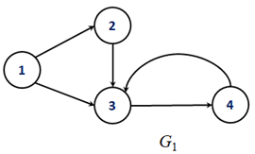
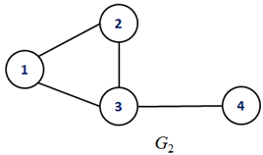
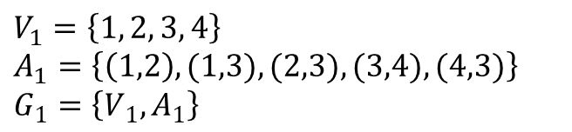
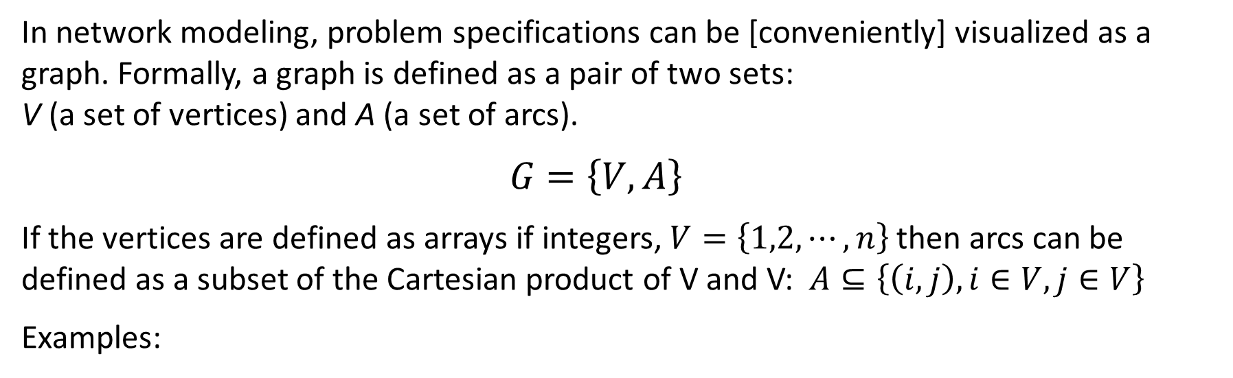
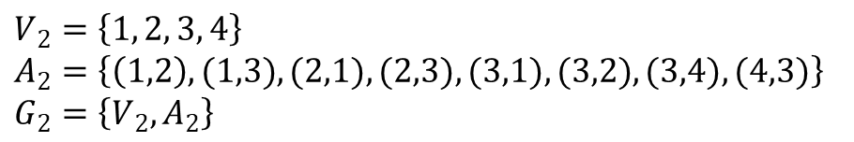
A Network Modeling – Structure
In network modeling, problem specifications can be [conveniently] visualized as a graph. Formally, a graph is defined as a pair of two sets:
V (a set of vertices) and A (a set of arcs).
  $$G=\left\{V,A\right\}$$
If the vertices are defined as arrays if integers, $V=\left\{1,2,⋯,n\right\}$ then arcs can be defined as a subset of the Cartesian product of V and V: $A⊆\left\{\left(i,j\right),i∈V, j∈V\right\}$
Examples:
$$V_{1}=\left\{1, 2, 3, 4\right\}$$
$$A_{1}=\left\{\left(1,2\right),(1,3),(2,3),(3,4),(4,3)\right\}$$
$$G_{1}=\left\{V_{1},A_{1}\right\}$$
$$V_{2}=\left\{1, 2, 3, 4\right\}$$
$$A_{2}=\left\{\left(1,2\right),(1,3),(2,1),(2,3),(3,1),(3,2),(3,4),(4,3)\right\}$$
$$G_{2}=\left\{V_{2},A_{2}\right\}$$

Slide 4
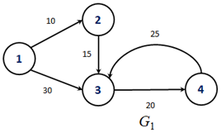
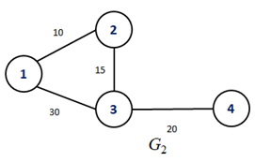
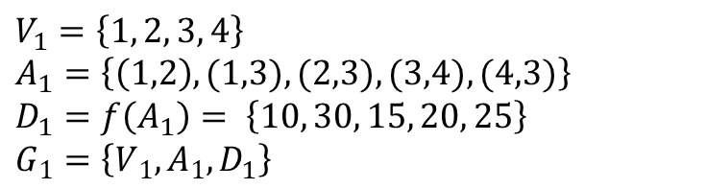
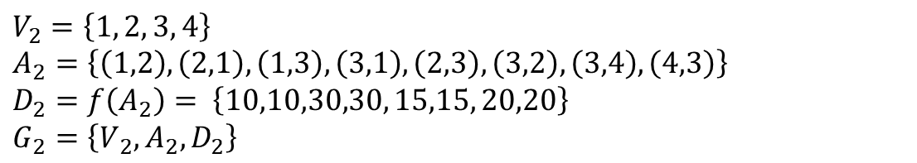
A Network Modeling – Properties
The graph structure can be extended by defining functions on vertices and/or arcs.
Examples:
$$V_{1}=\left\{1, 2, 3, 4\right\}$$
$$A_{1}=\left\{\left(1,2\right),(1,3),(2,3),(3,4),(4,3)\right\}$$
$$D_{1}=f\left(A_{1}\right)= \left\{10, 30, 15, 20, 25\right\}$$
$$G_{1}=\left\{V_{1},A_{1},D_{1}\right\}$$
$$V_{2}=\left\{1, 2, 3, 4\right\}$$
$$A_{2}=\left\{\left(1,2\right),\left(2,1\right),\left(1,3\right),\left(3,1\right),\left(2,3\right),\left(3,2\right),\left(3,4\right),\left(4,3\right)\right\}$$
$$D_{2}=f\left(A_{2}\right)= \left\{10,10,30,30, 15,15, 20,20\right\}$$
$$G_{2}=\left\{V_{2},A_{2},D_{2}\right\}$$
Mapping : A₂ → D₂
(1,2) → 10
(2,1) → 10
(1,3) → 30
(3,1) → 30
(2,3) → 15
(3,2) → 15
(3,4) → 20
(4,3) → 20
(1,2) → 10
(1,3) → 30
(2,3) → 15
(3,4) → 20
(4,3) → 25
Mapping : A₁ → D₁

Slide 5
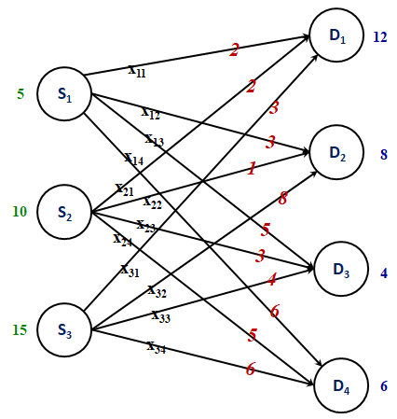



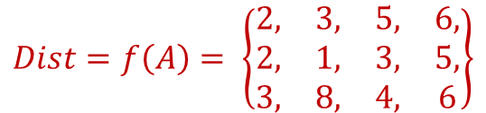
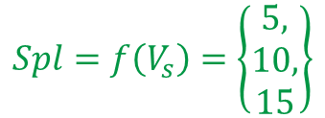
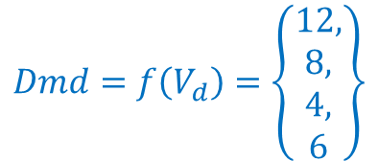
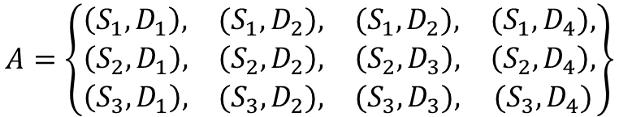
Transportation Problem - Structure
Consider a simple problem of moving (shipping) some goods from m sources directly to n destinations. The following example shows a 3 by 4 network (graph) model (m = 3, n = 4).
$$V_{s}=\left\{S_{1},S_{3},S_{3}\right\}$$
$$V_{d}=\left\{D_{1},D_{2},D_{3},D_{4}\right\}$$
$$A=\left\{\begin{matrix}\left(S_{1},D_{1}\right), & (S_{1},D_{2}), & (S_{1},D_{2}), & (S_{1},D_{4}), \\ \left(S_{2},D_{1}\right), & \left(S_{2},D_{2}\right), & \left(S_{2},D_{3}\right), & \left(S_{2},D_{4}\right), \\ \left(S_{3},D_{1}\right), & (S_{3},D_{2}), & (S_{3},D_{3}), & (S_{3},D_{4})\end{matrix}\right\}$$
$$Dist=f\left(A\right)= \left\{\begin{matrix}2, & 3, & 5, & 6, \\ 2, & 1, & 3, & 5, \\ 3, & 8, & 4, & 6\end{matrix}\right\}$$
$$Dmd=f\left(V_{d}\right)=\left\{\begin{matrix}12, \\ 8, \\ 4, \\ 6\end{matrix}\right\}$$
$$Spl=f\left(V_{s}\right)=\left\{\begin{matrix}5, \\ 10, \\ 15\end{matrix}\right\}$$
$$G=\left\{V_{s},V_{d},A,Dist,Spl,Dmd\right\}$$

Slide 6
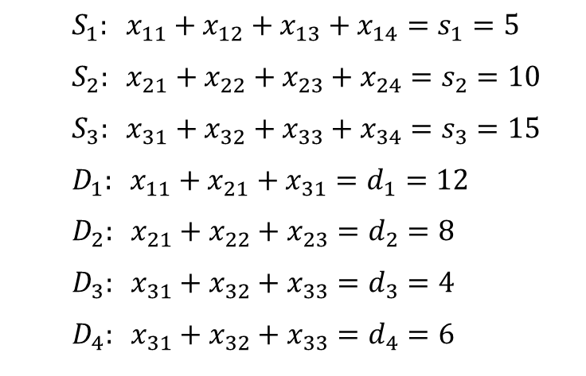
Capturing Relations
An important rule to be observed for the graph model is that, for every vertex, the total inflow is the same as the total outflow. What goes into a vertex, comes out from the vertex (vertex outflow is equal to vertex inflow).
For the supplier vertices (V_{s}), the inflow is fixed (supply quantities).
For the receiver vertices (V_{d}), the outflow is fixed (demand quantities).
Applying this rule to our example, we get the following constraints:
$$S_{1}: x_{11}+x_{12}+x_{13}+x_{14}=s_{1}=5$$
$${S_{2}: x}_{21}+x_{22}+x_{23}+x_{24}=s_{2}=10$$
$${S_{3}: x}_{31}+x_{32}+x_{33}+x_{34}=s_{3}=15$$
$$D_{1}: x_{11}+x_{21}+x_{31}=d_{1}=12$$
$${D_{2}: x}_{21}+x_{22}+x_{23}=d_{2}=8$$
$${D_{3}: x}_{31}+x_{32}+x_{33}=d_{3}=4$$
$${D_{4}: x}_{31}+x_{32}+x_{33}=d_{4}=6$$

Slide 7
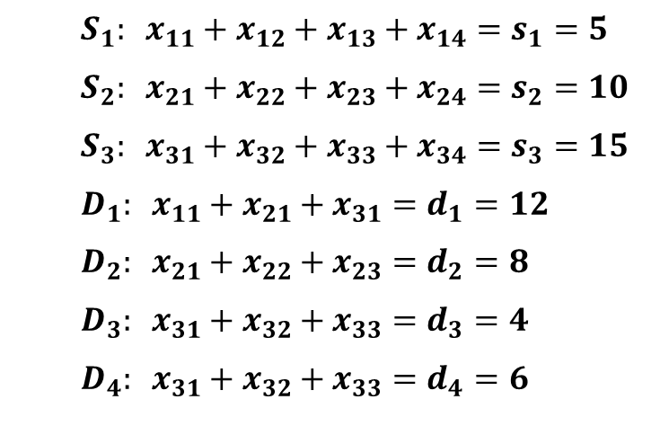
Capturing the Objective (Optimization Criterion)
Naturally, we want to satisfy the flow constraints at the lowest cost of the flow (transportation). In this case, we assume that the cost is proportional to the distance. Thus we use the distance to build the objective function.
$$Min Z=2x_{11}+3x_{12}+5x_{13}+6x_{14}+2x_{21}+1x_{22}+3x_{23}+5x_{24}+3x_{31}+8x_{32}+4x_{33}+6x_{34}$$
$$S_{1}: x_{11}+x_{12}+x_{13}+x_{14}=s_{1}=5$$
$${S_{2}: x}_{21}+x_{22}+x_{23}+x_{24}=s_{2}=10$$
$${S_{3}: x}_{31}+x_{32}+x_{33}+x_{34}=s_{3}=15$$
$$D_{1}: x_{11}+x_{21}+x_{31}=d_{1}=12$$
$${D_{2}: x}_{21}+x_{22}+x_{23}=d_{2}=8$$
$${D_{3}: x}_{31}+x_{32}+x_{33}=d_{3}=4$$
$${D_{4}: x}_{31}+x_{32}+x_{33}=d_{4}=6$$
Naturally, all the flow (shipments) are non-negative. With linear objective function and constraints, we can solve our problem using the SIMPLEX method.

Slide 8

Linear Programming Setup in R [1]
There are many R library that implement the SIMPLEX method. Let's first try library "linprog".
In a standard linear programming model, all decision variables must participate in the objective function and constraints. The objective function has the complete set of the decision variables. Our constraints have to be rewritten. The order of the variables has to be consistent. We will use the objective function as our pattern.
$$Min Z=2x_{11}+3x_{12}+5x_{13}+6x_{14}+2x_{21}+1x_{22}+3x_{23}+5x_{24}+3x_{31}+8x_{32}+4x_{33}+6x_{34}$$
Let's try to rewrite the first constraint:
$$S_{1}: x_{11}+x_{12}+x_{13}+x_{14}=5$$
Here, missing variables are $x_{14},x_{21},x_{22},x_{23},x_{24},x_{31},x_{32},x_{33},x_{34}$. They are shown in the objective explicitly and they must appear in all the constraints as well. For S₁ we have:
$$S_{1}: x_{11}+x_{12}+x_{13}+x_{14}+x_{14}+0x_{22}+0x_{23}+0x_{24}+0x_{31}+0x_{32}+0x_{33}+0x_{34}=5$$
In a similar way, the other constraints must be express with respect to all the decision variables.

Slide 9
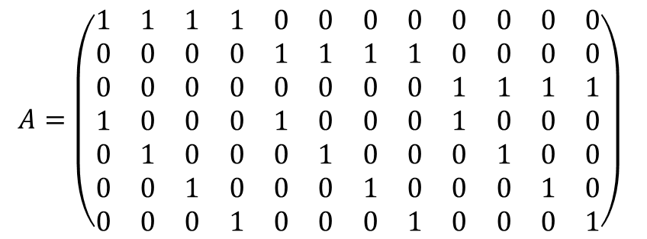
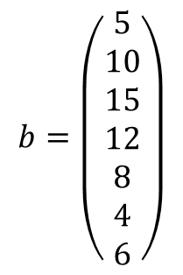
Linear Programming Setup in R [2]
When doing this modelling in R, we can automate some of the tedious tasks. Our job is to develop all the components (parameters) of the linear programming model. Using the standard approach, the R setup requires the following organization of the parameters.
Coefficients of the objective function (vector c):
$$c=\left(2, 3, 5, 6 2, 1, 3, 5, 3, 8, 4, 6\right)$$
Coefficients of the LHS of the constraints (matrix A):
The RHS coefficients:
$$A=\left(\begin{matrix}1 & 1 & 1 & 1 & 0 & 0 & 0 & 0 & 0 & 0 & 0 & 0 \\ 0 & 0 & 0 & 0 & 1 & 1 & 1 & 1 & 0 & 0 & 0 & 0 \\ 0 & 0 & 0 & 0 & 0 & 0 & 0 & 0 & 1 & 1 & 1 & 1 \\ 1 & 0 & 0 & 0 & 1 & 0 & 0 & 0 & 1 & 0 & 0 & 0 \\ 0 & 1 & 0 & 0 & 0 & 1 & 0 & 0 & 0 & 1 & 0 & 0 \\ 0 & 0 & 1 & 0 & 0 & 0 & 1 & 0 & 0 & 0 & 1 & 0 \\ 0 & 0 & 0 & 1 & 0 & 0 & 0 & 1 & 0 & 0 & 0 & 1\end{matrix}\right)$$
$$b=\left(\begin{matrix}5 \\ 10 \\ 15 \\ 12 \\ 8 \\ 4 \\ 6\end{matrix}\right)$$

Slide 10
Linear Programming Setup in R [3a]
R Code
# Install the library unless it is already set up.
install.packages("linprog")
# Use the library.
library(linprog)
# Define the coefficients of the objective function (vector vc).
vc = c(2, 3, 5, 6, 2, 1, 3, 5, 3, 8, 4, 6)
vc
[1] 2 3 5 6 2 1 3 5 3 8 4 6
# The right-hand-side coefficients of the constraints (vector vb).
vb = c(5, 10, 15, 12, 8, 4, 6)
vb
[1] 5 10 15 12 8 4 6

Slide 11
Linear Programming Setup in R [3b]
R Code
# Define the size of the original decision (or cost) matrix.
# m = the number of the suppliers and n = the number of receivers.
m = 3
n = 4
# Create a matrix of zeros, having m + n (here 7) rows and
# m * n (here 12) columns, as shown above in (4.14).
A = matrix(0, nrow=m+n, ncol=m*n)
A
[,1] [,2] [,3] [,4] [,5] [,6] [,7] [,8] [,9] [,10] [,11] [,12]
[1,] 0 0 0 0 0 0 0 0 0 0 0 0
[2,] 0 0 0 0 0 0 0 0 0 0 0 0
[3,] 0 0 0 0 0 0 0 0 0 0 0 0
[4,] 0 0 0 0 0 0 0 0 0 0 0 0
[5,] 0 0 0 0 0 0 0 0 0 0 0 0
[6,] 0 0 0 0 0 0 0 0 0 0 0 0
[7,] 0 0 0 0 0 0 0 0 0 0 0 0

Slide 12
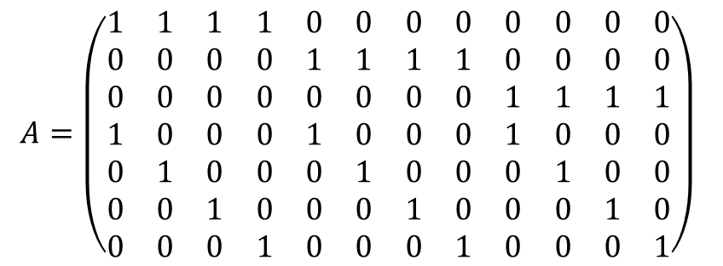
Linear Programming Setup in R [3c]
R Code
# Show the matrix.
A
[,1] [,2] [,3] [,4] [,5] [,6] [,7] [,8] [,9] [,10] [,11] [,12]
[1,] 1 1 1 1 0 0 0 0 0 0 0 0
[2,] 0 0 0 0 1 1 1 1 0 0 0 0
[3,] 0 0 0 0 0 0 0 0 1 1 1 1
[4,] 1 0 0 0 1 0 0 0 1 0 0 0
[5,] 0 1 0 0 0 1 0 0 0 1 0 0
[6,] 0 0 1 0 0 0 1 0 0 0 1 0
[7,] 0 0 0 1 0 0 0 1 0 0 0 1
# Produce the first m rows.
for (i in 1:m) {
for (j in 1:n) {
A[i,j+n*(i-1)] = 1
}
}
# Produce the next n rows.
for (j in 1:n) {
for (i in 1:m) {
A[m+j,j+n*(i-1)] = 1
}
}
This is what we need!
$$A=\left(\begin{matrix}1 & 1 & 1 & 1 & 0 & 0 & 0 & 0 & 0 & 0 & 0 & 0 \\ 0 & 0 & 0 & 0 & 1 & 1 & 1 & 1 & 0 & 0 & 0 & 0 \\ 0 & 0 & 0 & 0 & 0 & 0 & 0 & 0 & 1 & 1 & 1 & 1 \\ 1 & 0 & 0 & 0 & 1 & 0 & 0 & 0 & 1 & 0 & 0 & 0 \\ 0 & 1 & 0 & 0 & 0 & 1 & 0 & 0 & 0 & 1 & 0 & 0 \\ 0 & 0 & 1 & 0 & 0 & 0 & 1 & 0 & 0 & 0 & 1 & 0 \\ 0 & 0 & 0 & 1 & 0 & 0 & 0 & 1 & 0 & 0 & 0 & 1\end{matrix}\right)$$

Slide 13
Linear Programming Setup and Solution in R [4a]
R Code
# Since all our constrains represent equalities (=), we can generate
# a vector of m + n equal signs, using function rep.
const_dir = rep("=",n+m)
const_dir
[1] "=" "=" "=" "=" "=" "=" "="
# We have all the necessary ingredients for the solveLP() function.
opt = solveLP(cvec = vc, bvec = vb, Amat = A, maximum=FALSE, const.dir= const_dir, lpSolve=TRUE)
# Find out if the function has succeeded.
opt$lpSolve
[1] TRUE
# Show the solution (shipments).
opt$solution
1 2 3 4 5 6 7 8 9 10 11 12
5 0 0 0 2 8 0 0 5 0 4 6
# Show the value of the objective function (the total shipment cost
# for the optimal silution.
opt$opt
[1] 89

Slide 14
Linear Programming Setup and Solution in R [4b]
R Code – Reorganize the outcomes in a more friendly way.
# Convert the solution vector, opt$solution to matrix X, row by row.
X = matrix(opt$solution, nrow=m, ncol=n, byrow=TRUE)
# Also customize row and column labels as sources (S1, S2, S3) and
# destinations (D1,D2,D3,D4).
rownames(X) = paste("S",1:m,sep="")
colnames(X) = paste("D",1:n,sep="")
X
D1 D2 D3 D4
S1 5 0 0 0
S2 2 8 0 0
S3 5 0 4 6
# Extract the supply values from the RHS vector b.
supply = vb[1:m]
# Calculate the total shipment.
total_shipment = sum(vb[1:m])
# Create vector demand, using the extracted demand values from the RHS
# vector b and the total shipment.
demand = c(vb[(m+1):(m+n)], total_shipment)

Slide 15
Linear Programming Setup and Solution in R [4c]
R Code – Reorganize the outcomes in a more friendly way.
# Combine matrix X with the supply column.
tr_report = cbind(X, supply)
# combine matrix X with the demand row.
tr_report = rbind(tr_report, demand)
# Show the transportation solution.
tr_report
D1 D2 D3 D4 supply
S1 5 0 0 0 5
S2 2 8 0 0 10
S3 5 0 4 6 15
demand 12 8 4 6 30
The above R procedures are interesting and they contribute to better understanding of the R language. In particular, the students practice and learn more about vectors and matrices.
However, for the busy individuals, there exist another library ("lpSolve") that is equipped with a transportation-friendly function, lp.transport. Its utilization is straight forward. It does not require writing and rewriting of the LP model's structures. The next slide show how to use it.

Slide 16
Linear Programming Setup and Solution in R [5a]
R Code
# Install the "igraph" library unless it is already set up.
install.packages("igraph")
# Use the library.
library(igraph)
# Define the coefficients of the objective function as a matrix.
mxC = read.table(text = '2 3 5 6
2 1 3 5
3 8 4 6', header=FALSE)
# read.table has created a data.frame.
# Convert it to a matrix.
mxC = as.matrix(mxC)
colnames(mxC) = NULL
mxC
[,1] [,2] [,3] [,4]
[1,] 2 3 5 6
[2,] 2 1 3 5
[3,] 3 8 4 6
# The supply vector.
vs = c(5, 10, 15)
vs
[1] 5 10 15
# The demand vector.
vd = c(12, 8, 4, 6)
vd
[1] 12 8 4 6
# Size of the problem (matrix)
m = length(vs)
n = length(vd)
# Relational operators for supply.
vrels = rep("=",m)
vrels
[1] "=" "=" "="
# Relational operators for demand.
vreld = rep("=",n)
vreld
[1] "=" "=" "=" "="
# Solve this transportation problem.
trs = lp.transport(
cost.mat=mxC, direction="min",
row.signs=vrels, row.rhs=vs,
col.signs=vreld, col.rhs=vd,
integers = 1:(m*n) )

Slide 17
Linear Programming Setup and Solution in R [5b]
R Code – Explore the Solution
# The following statement (repeated intentionally):
trs = lp.transport(
cost.mat=mxC, direction="min",
row.signs=vrels, row.rhs=vs,
col.signs=vreld, col.rhs=vd,
integers = 1:(m*n) )
# has produced:
trs
Success: the objective function is 89
# It has many useful properties.
# Solution:
trs$solution
[,1] [,2] [,3] [,4]
[1,] 5 0 0 0
[2,] 2 8 0 0
[3,] 5 0 4 6
# Exhausted supply (row supplies).
trs$rrhs
[1] 5 10 15
# Satisfied demand (column demands).
trs$crhs
[1] 12 8 4 6
# Let's produce a final report (similar to the one shown
# on Slide 15).
trRpt = data.frame( trs$solution, trs$rrhs )
trRpt = rbind( trRpt, c( trs$crhs, sum(trs$crhs) ) )
colnames(trRpt) = c( paste("D", 1:n, sep=""), "supply" )
rownames(trRpt) = c( paste("S", 1:m, sep=""), "demand" )
trRpt
D1 D2 D3 D4 supply
S1 5 0 0 0 5
S2 2 8 0 0 10
S3 5 0 4 6 15
demand 12 8 4 6 30

Slide 18
Network-Graph Visualization in R [1]
R Code – Utilizing package "igraph".
# Install package "igraph", unless it is already installed.
packages.install('igraph')
# Load the package.
library('igraph')
# Set a graph (network model), consisting of nodes and edges.
# The X matrix is part of the above solution.
X = trRpt[1:m,1:n]
X
D1 D2 D3 D4
S1 5 0 0 0
S2 2 8 0 0
S3 5 0 4 6
nodes = c(rownames(X),colnames(X))
nodes
[1] "S1" "S2" "S3" "D1" "D2" "D3" "D4"
# Since each of the S nodes is to be connected with each of the D nodes, the from and to nodes
# can be generated as follows.
# Create a vector of the source nodes.
from = c('S1','S1','S1','S1','S2','S2','S2','S2','S3','S3','S3','S3')
# Create a vector of the destinations nodes.
to = c('D1','D2','D3','D4','D1','D2','D3','D4','D1','D2','D3','D4')
# Notice that pairs of from and to elements define the edges of the graph.
edges = data.frame(from, to)

Slide 19
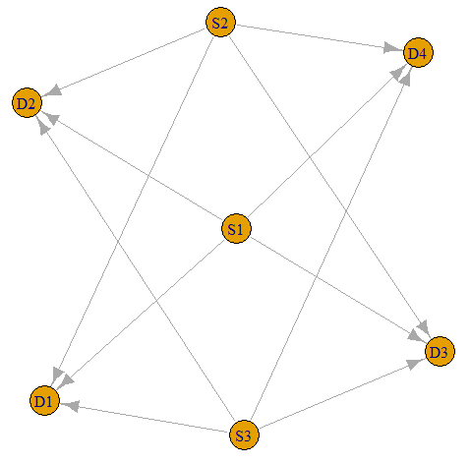
Network-Graph Visualization in R [2]
R Code – Utilizing package "igraph".
edges
from to
1 S1 D1
2 S1 D2
3 S1 D3
4 S1 D4
5 S2 D1
6 S2 D2
7 S2 D3
8 S2 D4
9 S3 D1
10 S3 D2
11 S3 D3
12 S3 D4
# Create the graph.
transp_net = graph_from_data_frame(d = edges, vertices = nodes, directed = TRUE)
# Display the graph.
plot(transp_net)
Notice that this is a plain and randomly organized graph.
My paper show how to better arrange the nodes and hoe to "dress up" this graph.

Slide 20
Related Documents
Supporting documents are available at this URL:
http://biiat.com/conference/2020/aabri/SanAntonio/
You will find there this presentation (as PowerPoint and PDF documents), R-scripts, and my Video based on this presentation.
Question & Comments are Very Welcome.
Please send them by e-mail to jerzy@wne.edu with subject AABRI.

Slide 21
References
[1] solveLP
https://www.rdocumentation.org/packages/linprog/versions/0.9-2/topics/solveLP
[2] lp.transport
https://www.rdocumentation.org/packages/lpSolve/versions/5.6.15/topics/lp.transport
[3] igraph
https://igraph.org/r/

